Slide 1


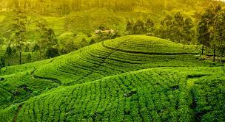

TeaBot
Tea Plantation Preservation Using an Intelligent Robot

Slide 2

Introducing TeaBot…
TeaBot is a well developed autonomous robot to replace the human resource
Watering and fertilizing for tea estates. (Liquid fertilization)
Operate in off road conditions
No need a highly arranged clear paths to navigate.
Increasing the efficiency and decrease the water and fertilizer wastage.
TeaBot can identify the path to navigate and identify the end of the plant stems and liquid fertilizing the plants efficiently.

Slide 3

Research Question
How to develop the TeaBot for the liquid fertilization process efficiently?

Slide 4
Objectives
Develop the robot controller of the TeaBot to navigate in off-road conditions with the computer vision guidance.
The development of the image segmentation model to navigate the robot automatically in the tea plantation rows in varying environmental conditions
Develop an image processing algorithm to precisely identify the end of the tea stem and pass the coordinators to the liquid spraying controller.
Develop the liquid nozzles controller of the TeaBot to liquid fertilize the tea plants more efficiently.

Slide 5
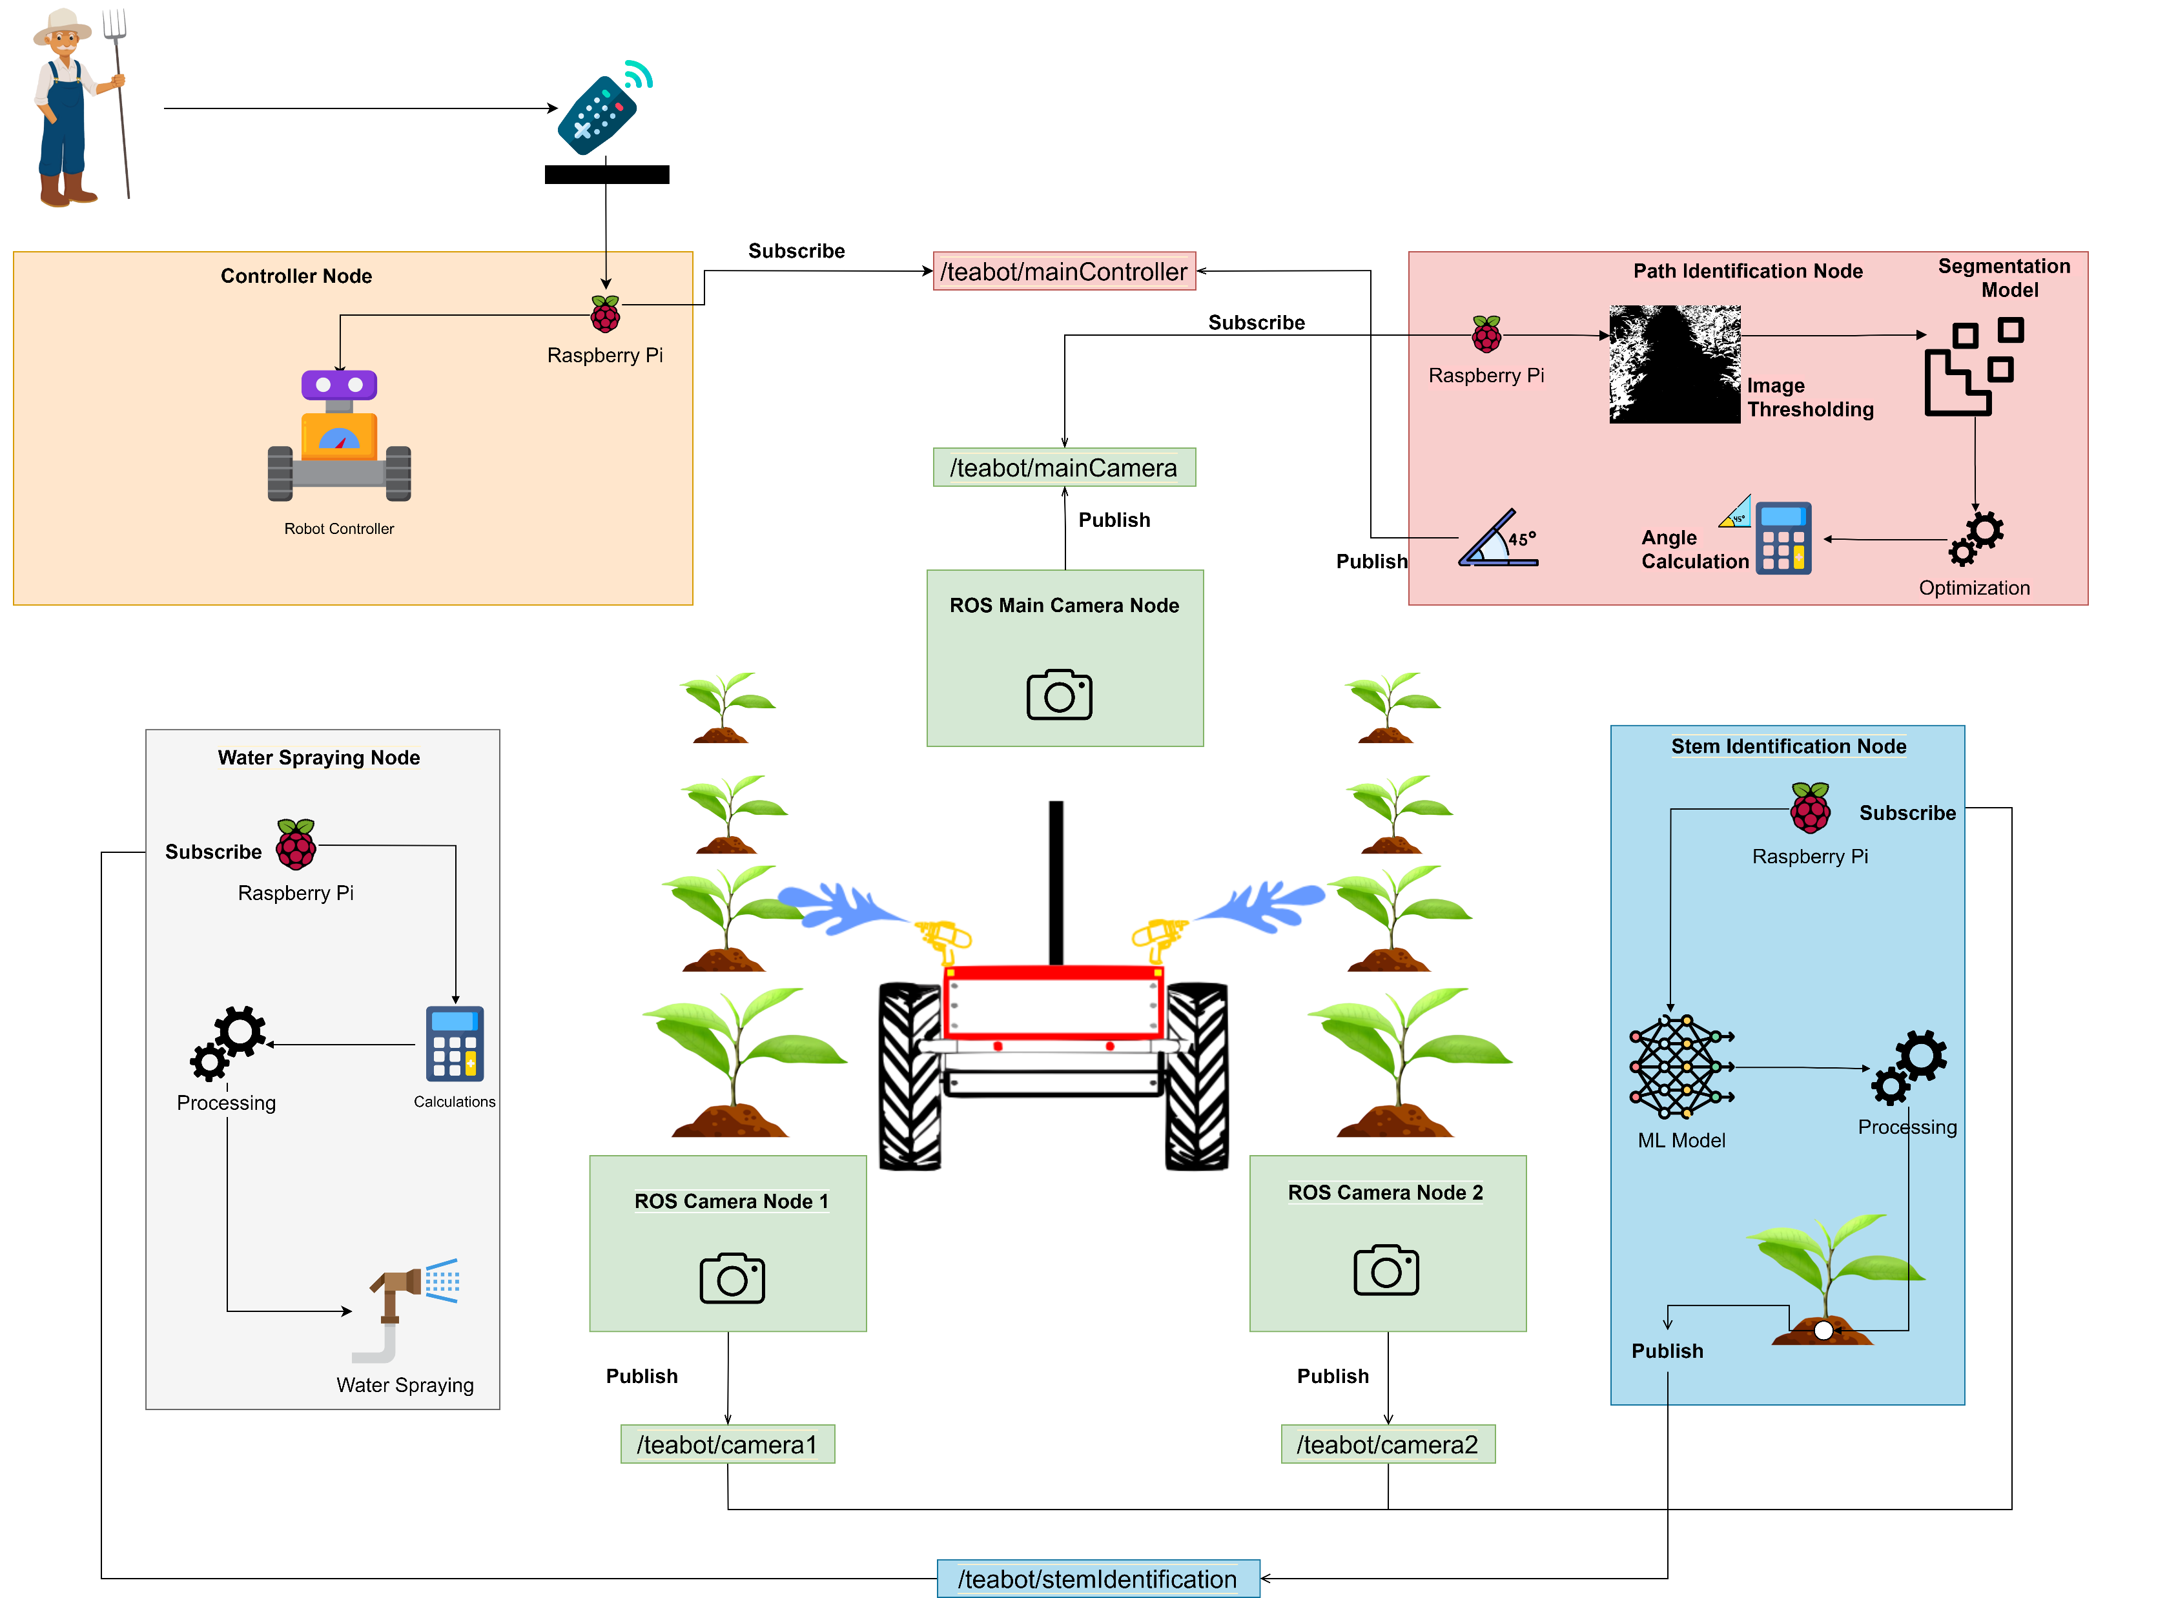
System Overview Diagram

Slide 6
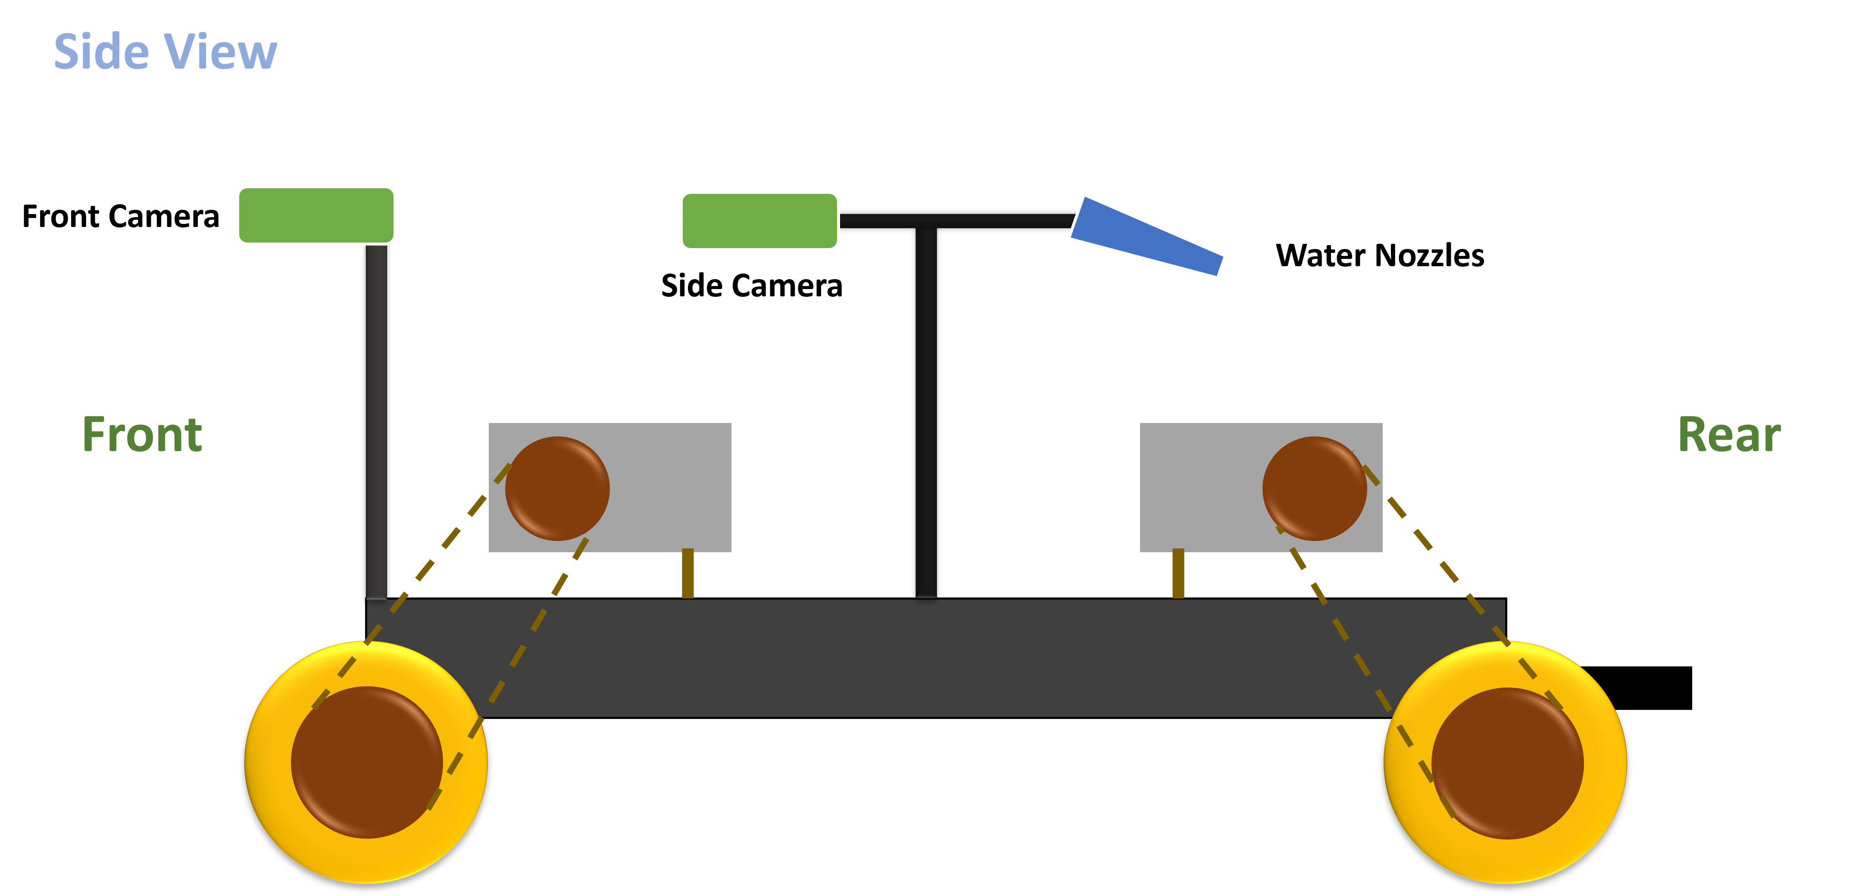
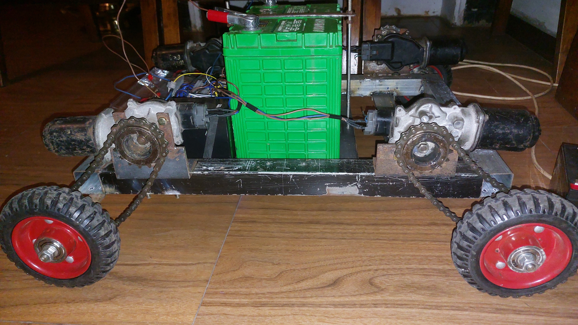

Slide 7
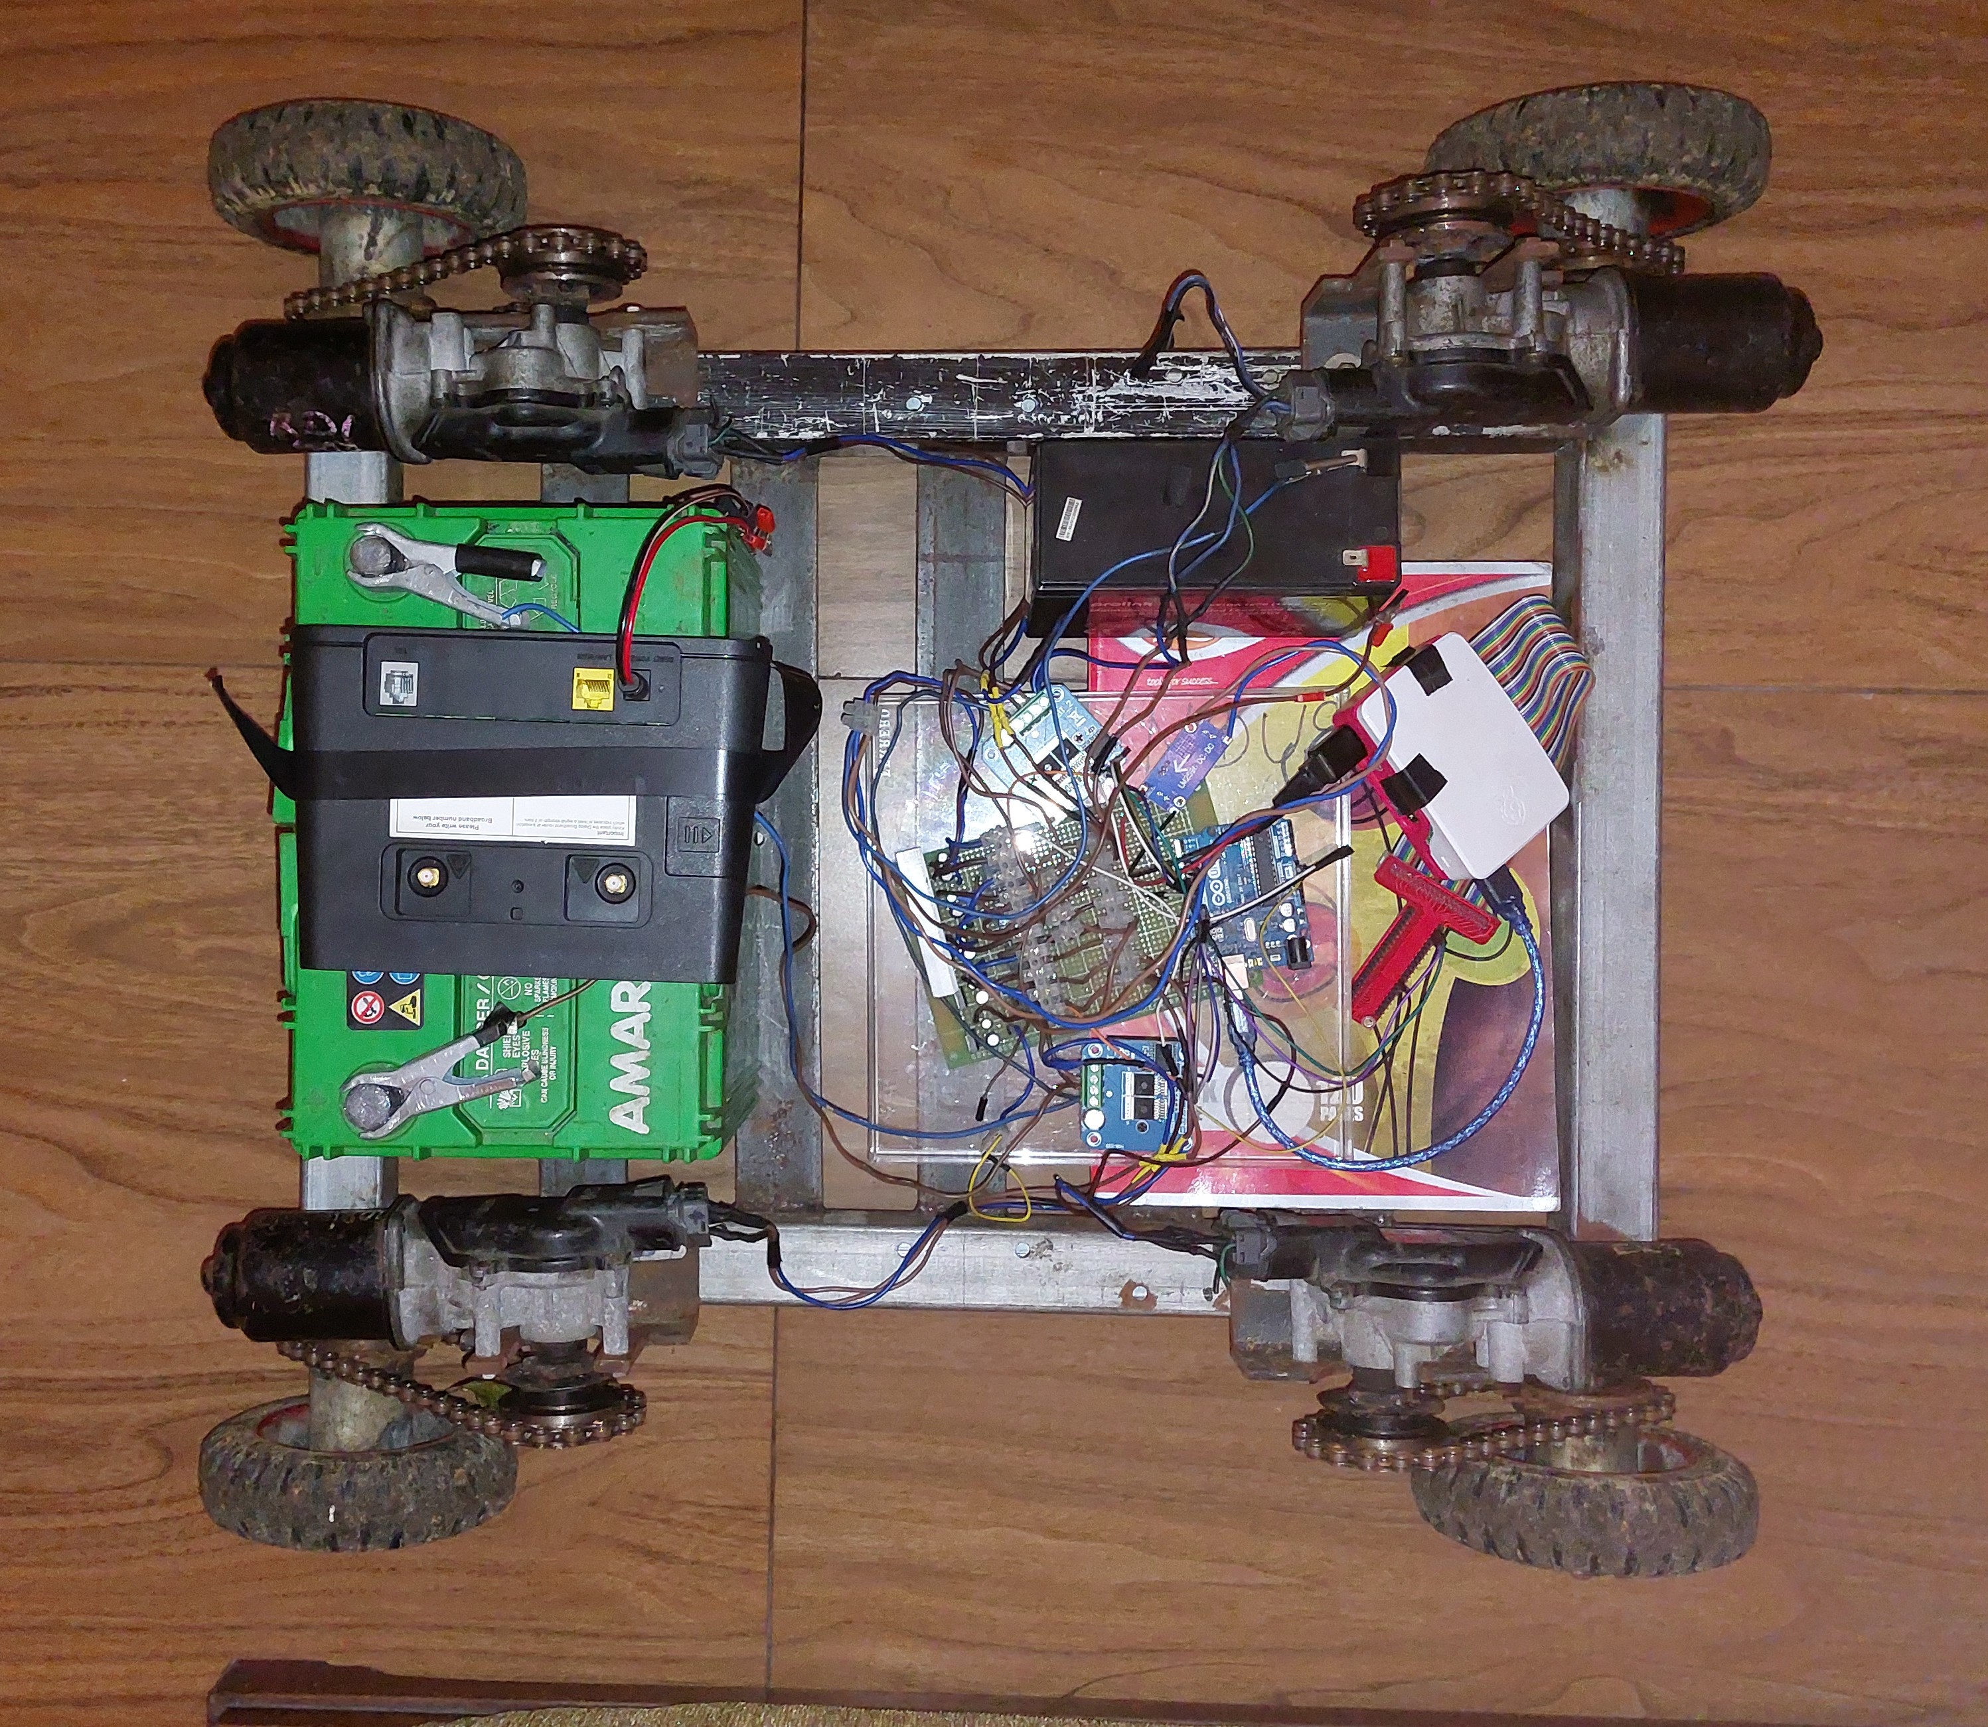
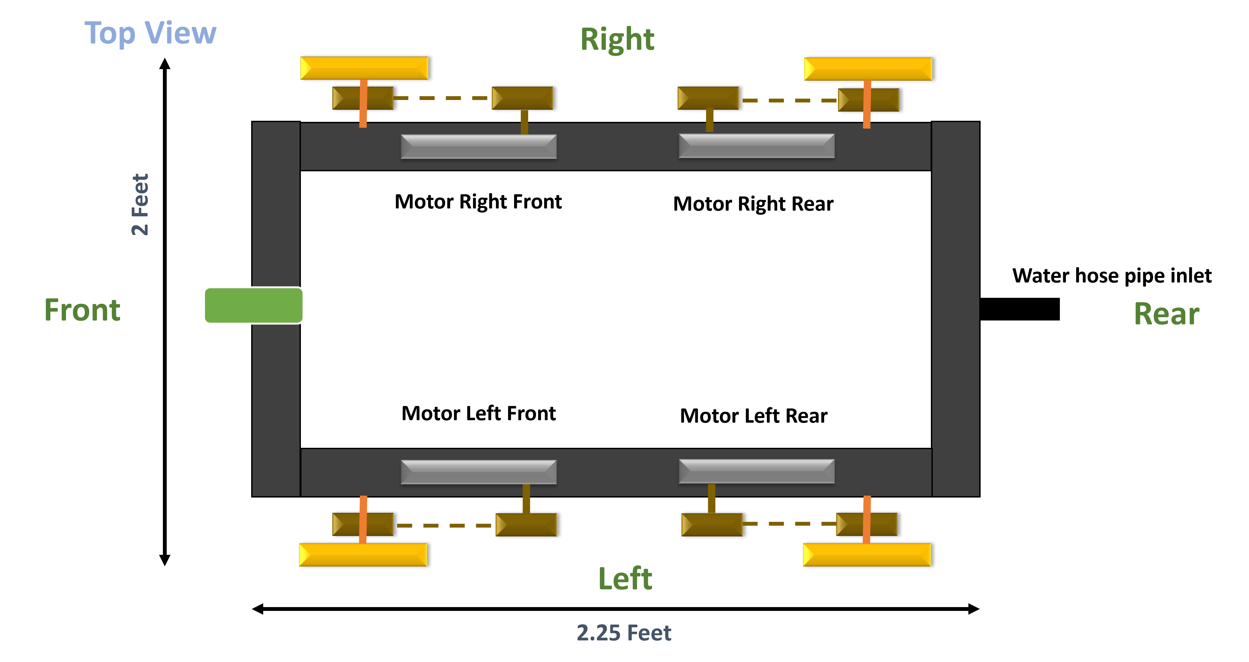

Slide 8
Robot Operating System
Why we use ROS? | Without ROS
Cooperate the components with low coupling and reduce the dependencies | have the possibilities to communicate the components
Can create the components separate. Each component is called as a node | Difficult to update the components since it has no proper convention to cooperate
nodes are communicating with ROS topics to send and receive data among the components | In programming, called it as low coupling high cohesion
Nodes are performing as publisher and subscriber | reduce the dependency level of the components
similar to the process of MQTT protocol
IT19973470 | Gunawardana I.I.E | 2023-044

Slide 9
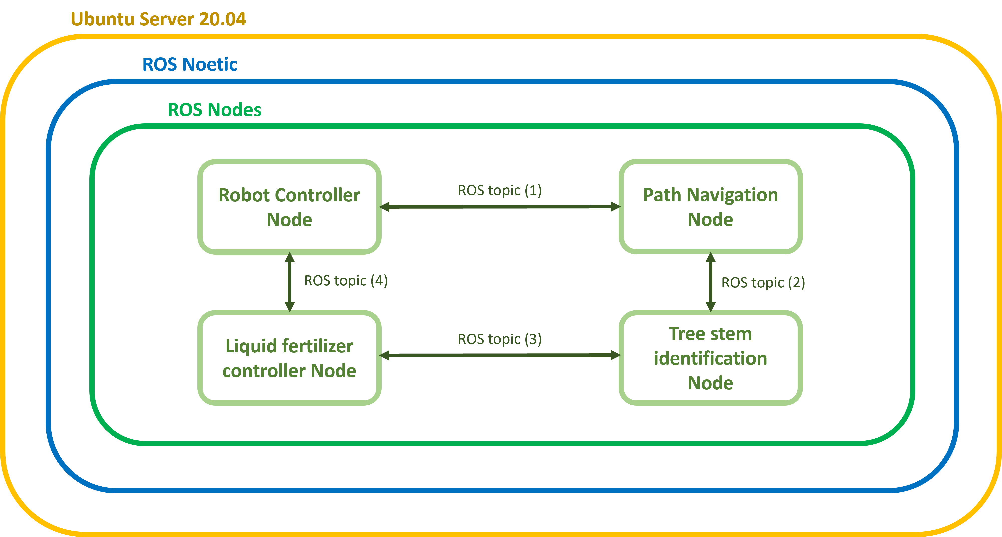

Slide 10
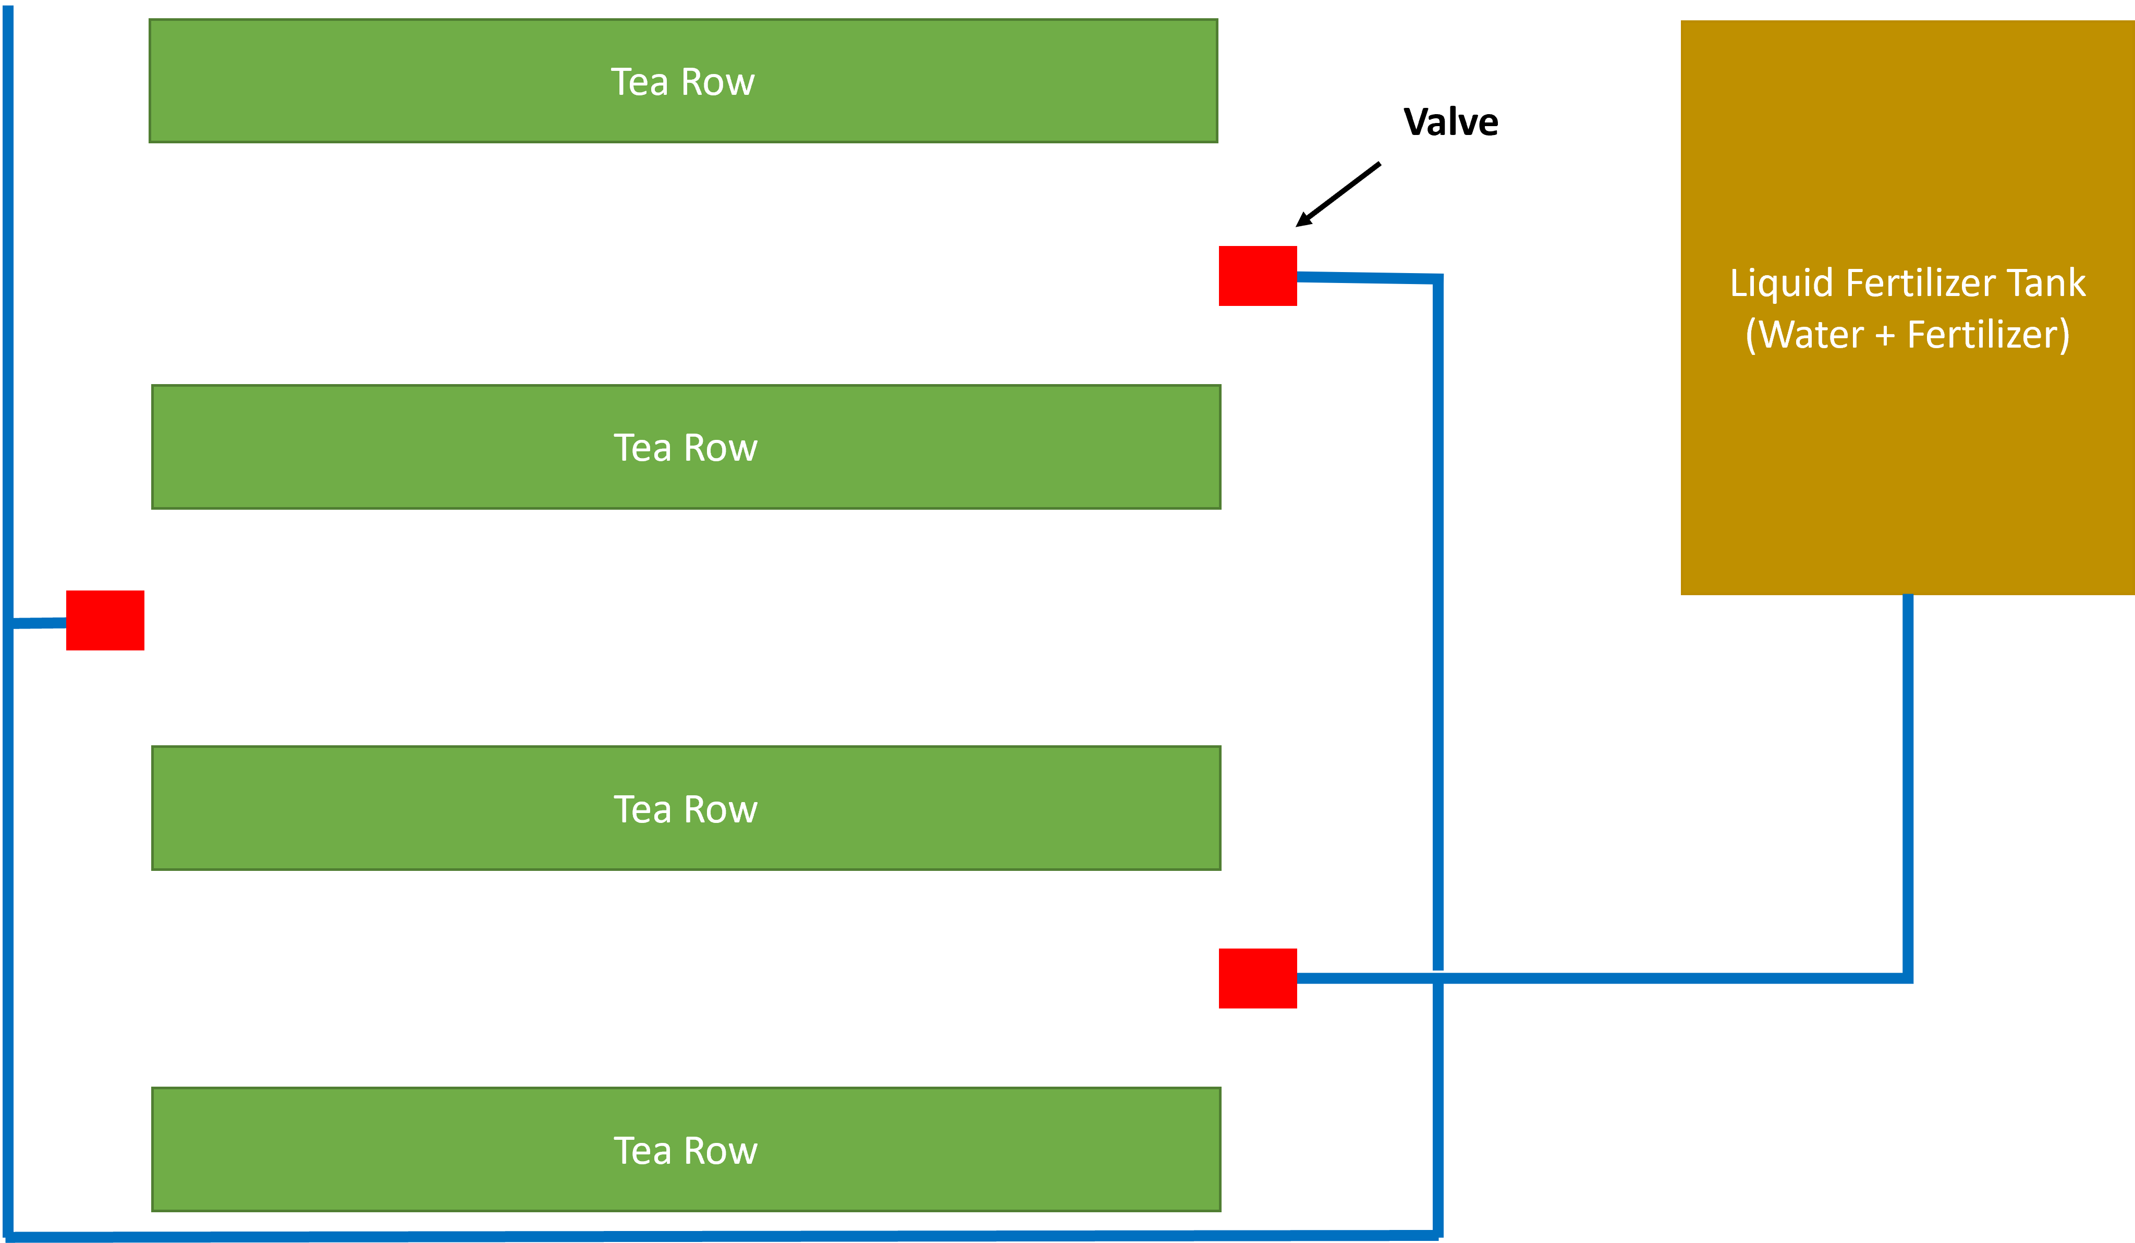
What is liquid fertilization?

Slide 11
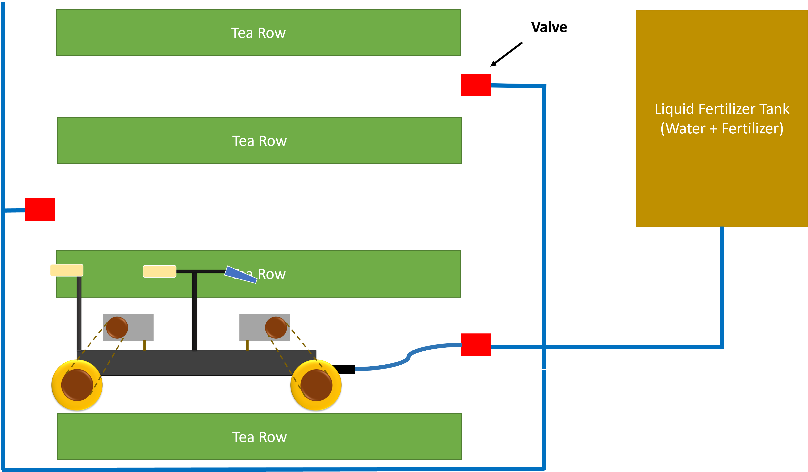

Slide 12
Budget
Item | Quantity | Amount (LKR)
Rubber wheels | 4 | 4,000
Sprocket, chain and wheel (gear system) | 4 | 10,800
Iron frame | 1 | 15,500
Motors | 4 | 14,000
43A Motor drivers | 4 | 5,400
Raspberry Pi | 1 | 90,000
12V 65Ah battery | 1 | 45,000
12V 8Ah battery | 1 | 5,000
Camera | 3 | 15,000
Liquid nozzles | 2 | 3,000
Servo motors | 8 | 9,600
Total |  | 220,000

Slide 13

IT19973470 Gunawardana I.I.E Software Engineering
IT19973470 | Gunawardana I.I.E | 2023-044

Slide 14
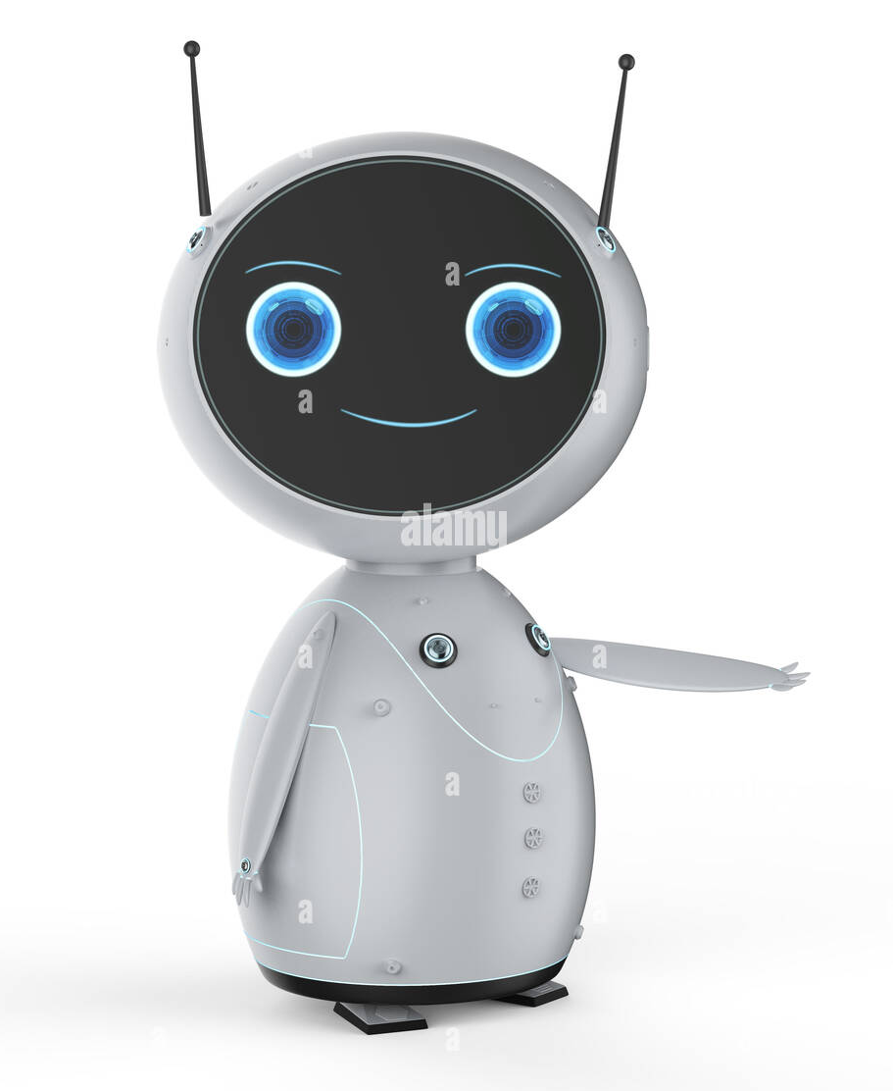
INTRODUCTION
IT19973470 | Gunawardana I.I.E | 2023-044

Slide 15
Background
How to drive the robot?
How to do the power management of the robot?
How to operate the robot with Raspberry Pi and Arduino?
How to operate the robot with ROS?
How will the path navigation drive the robot autonomous?
IT19973470 | Gunawardana I.I.E | 2023-044

Slide 16
Research Question
How to navigate the TeaBot efficient in off-road conditions with the computer vision guidance and maintain the power more effective?
IT19973470 | Gunawardana I.I.E | 2023-044

Slide 17
OBJECTIVES
IT19973470 | Gunawardana I.I.E | 2023-044

Slide 18
Specific and Sub Objectives
Main Objective
Develop the robot controller of the TeaBot to navigate in off-road conditions with the computer vision guidance.
Sub-Objectives
Design the robot chassis to easily drive, easy to handle and consume low power and low cost to build.
Navigate the robot with the Twist library for the given linear velocity to go forward and backward and angles to steer.
Read the coordinates given by the computer vision to navigate the robot in the track and manual control if needed.
Emergency stop the robot if any hazard occurred
IT19973470 | Gunawardana I.I.E | 2023-044

Slide 19
METHODOLOGY
System Overview Diagram
Technologies
Requirements
Work Breakdown Structure
IT19973470 | Gunawardana I.I.E | 2023-044

Slide 20
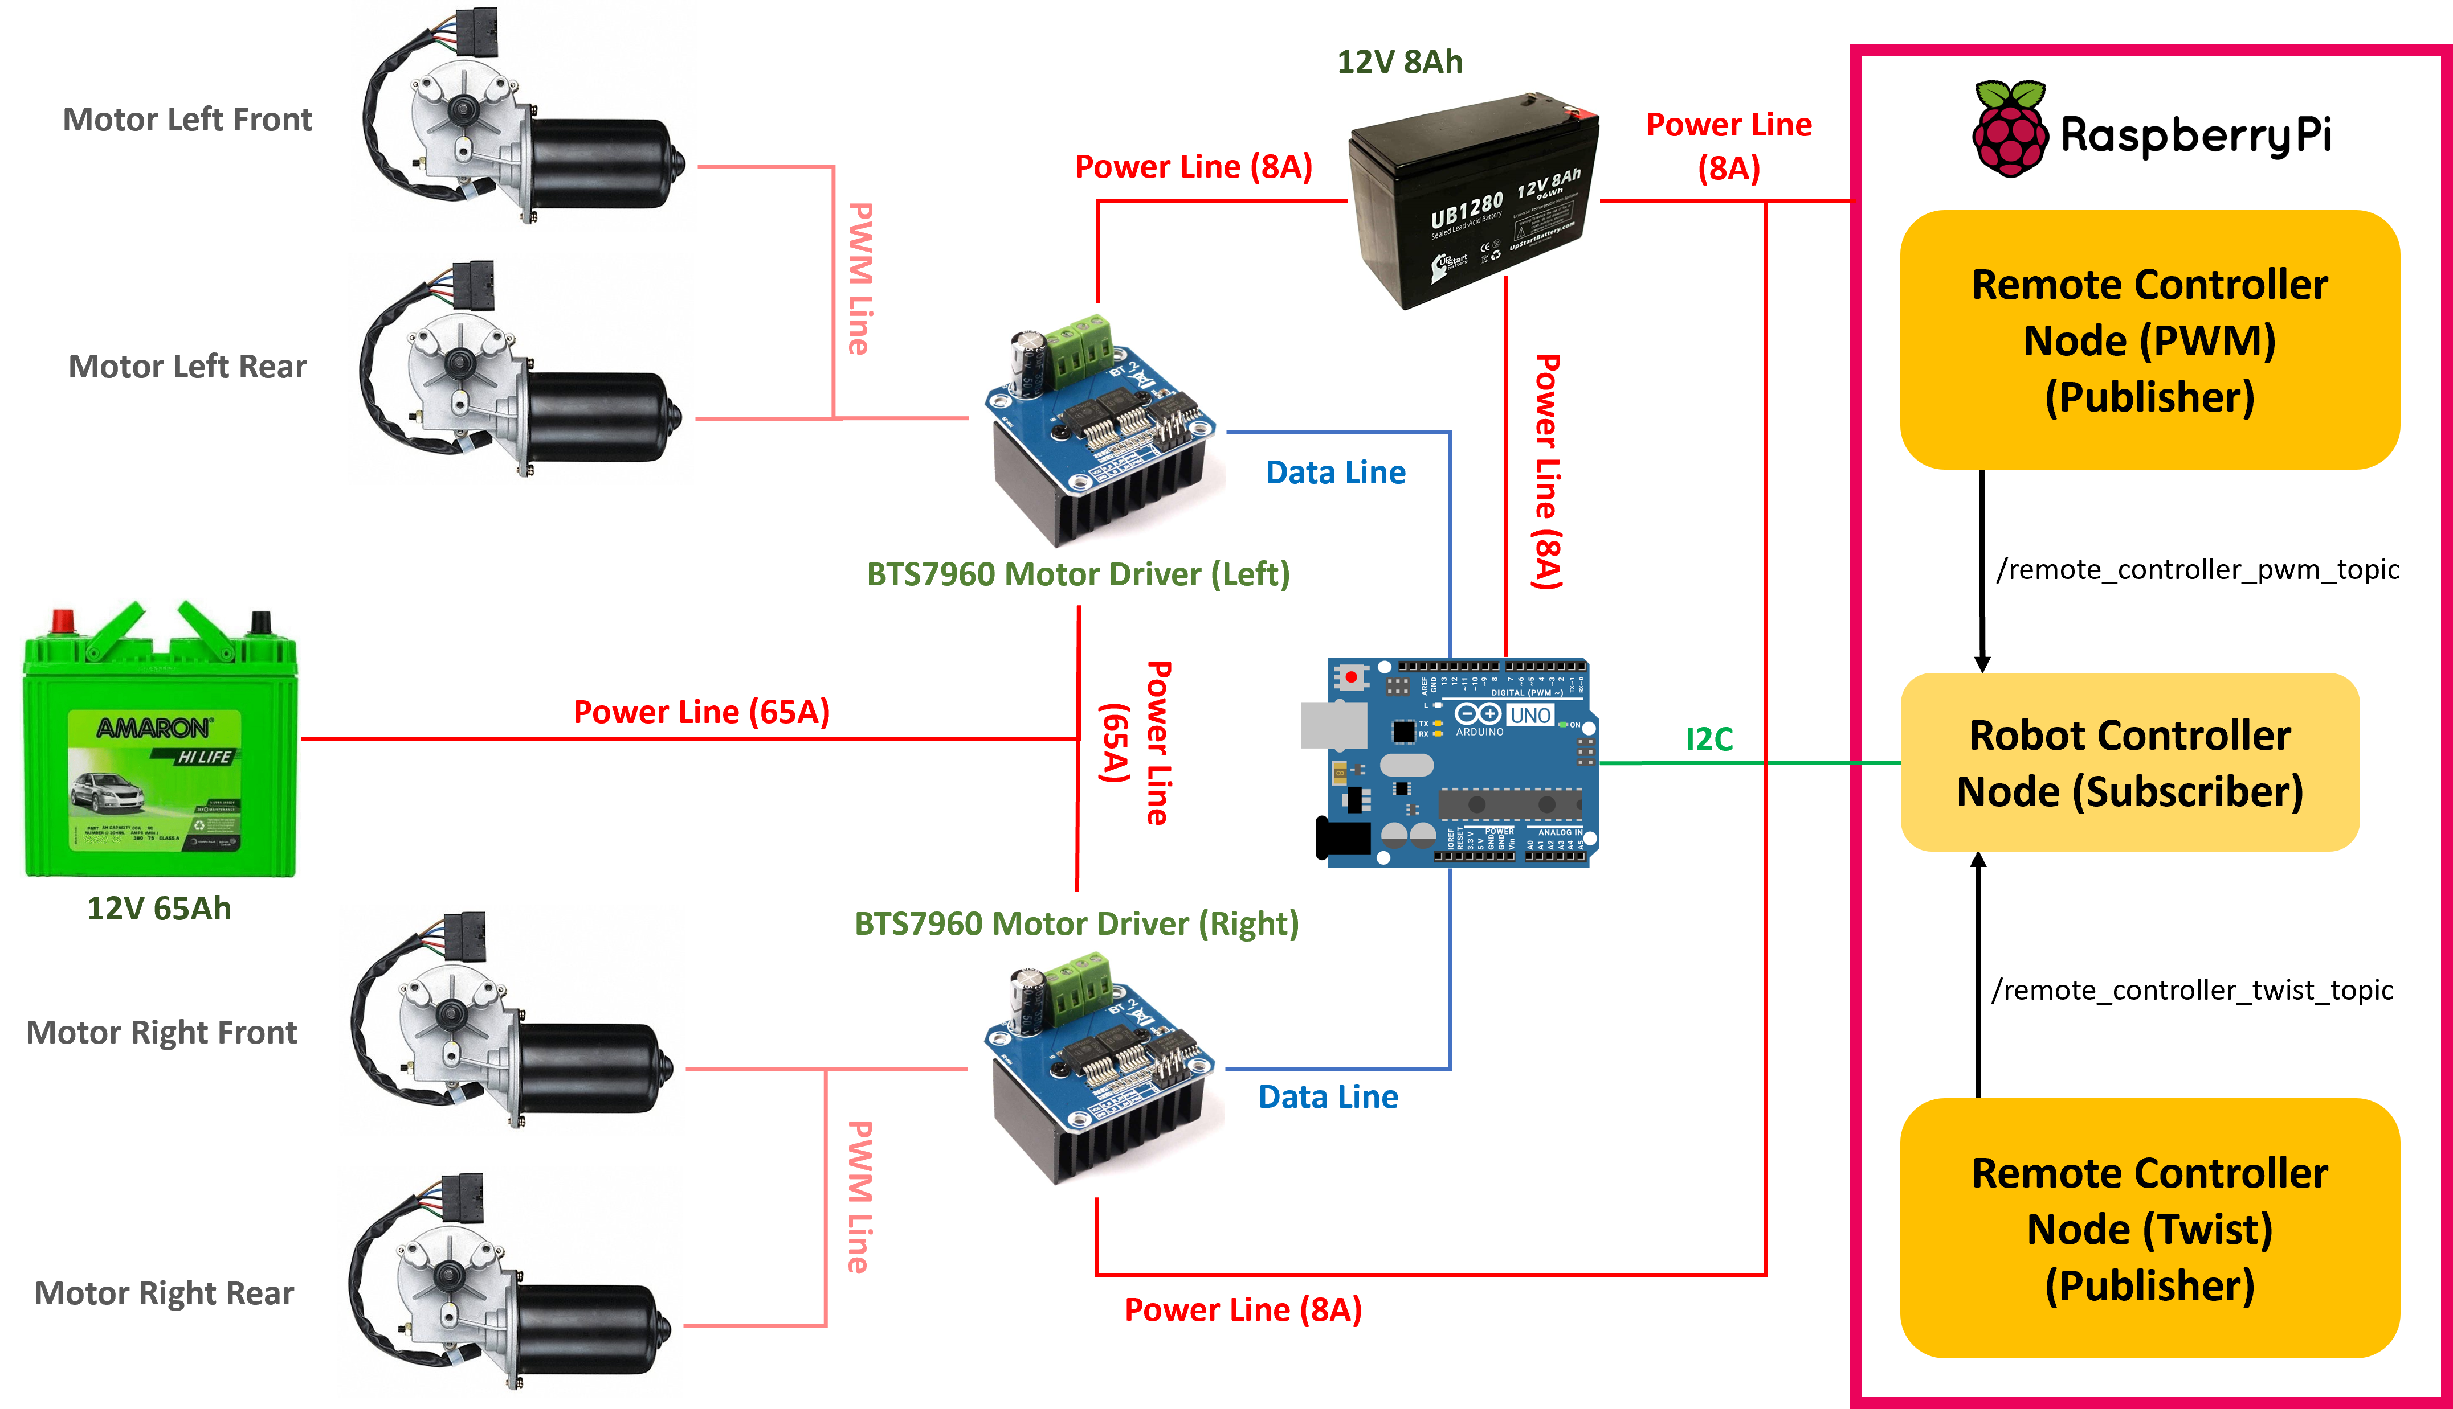
System Overview Diagram
IT19973470 | Gunawardana I.I.E | 2023-044

Slide 21
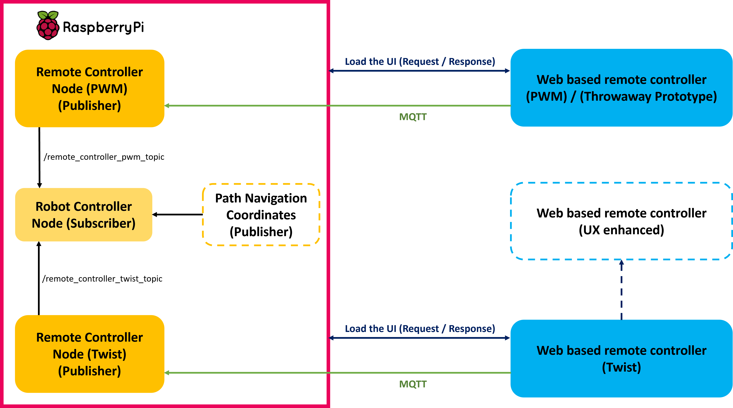
IT19973470 | Gunawardana I.I.E | 2023-044

Slide 22
Twist Library
Why we use Twist? | Without Twist
Capable to provide the linear velocity and the angle to the ROS node | Have the possibilities to provide velocity and the angle by creating a custom python class
Pass the linear velocities for the x, y, z directions | But arising problems when connecting the nodes because of custom classes.
Pass the angles for the x, y, z directions | Not maintaining a convention to communicate among nodes
Robot controller’s data in and out are defined by the Twist library
Can create a separate node with Twist library to provide the linear and angles to the robot controller
No need to change any coding level of the robot controller
Twist is a convention
IT19973470 | Gunawardana I.I.E | 2023-044

Slide 23





Technologies
Technologies
Python
ROS Noetic
Algorithms
Twist to PWM
Motor Control
Angular
Ubuntu 20.04
MQTT
IT19973470 | Gunawardana I.I.E | 2023-044

Slide 24
Requirements
Functional Requirements
Non-Functional Requirements
Efficient
Easy to handle
Navigate the robot forward and backward
Driving the robot with the computer vision coordinates
Capability of hazards identification
Drive the robot in manual mode
Performance
IT19973470 | Gunawardana I.I.E | 2023-044

Slide 25
Work Breakdown Structure
Robot Controller
Motor Controller
Autopilot
Remote Controller
Hazard Identification
Drive
Make the robot structure
Provide computer vision coordinates
Angular app for remote development
Make the hardware
Drive the robot by providing PWM values
Make the power supply
Test the robot autopilot
Create the communication
Develop an algorithm to emergency stop
Drive the robot forward, backward, steer left and right
Create the motor driving
Drive it in off road conditions to test
Twist library to linear and angular movements
Completed
To Be Completed
Drive the robot with Twist library
IT19973470 | Gunawardana I.I.E | 2023-044

Slide 26
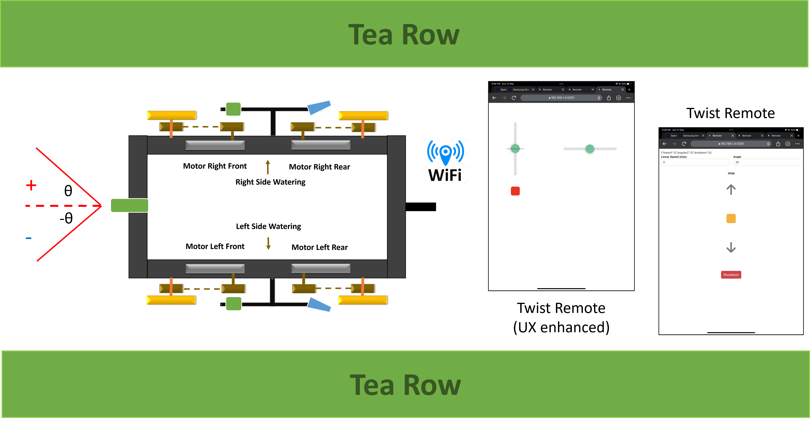
Evaluation
IT19973470 | Gunawardana I.I.E | 2023-044

Slide 27
Move forward or backward
Set the speed to drive (Twist)
Steering according to the given angles
Turn left or right while driving forward or backward (Twist)
Skid steer to left or right
Smooth driving
Optimized to protect the motors from sudden start or stop
One dedicated battery for the motors for the maximum power
Another dedicated battery for the drivers + Arduino + raspberry for a better performance
Tested in a hard environment
Hardware (Robot Chassis)
6 inches wheels – 4
Wiper motors (2 to 10 amps) – 4
Bicycle sprocket wheels (18 and 16) – 4
Bicycle chains – 4
Box bar + flat iron
BTS7960 motor drivers – 4
Arduino Uno – 1
Cost – Rs. 56,300
Raspberry Pi 4 – 1
12V 65A battery
12V 8A battery
Cost – Rs. 201,300
IT19973470 | Gunawardana I.I.E | 2023-044

Slide 28
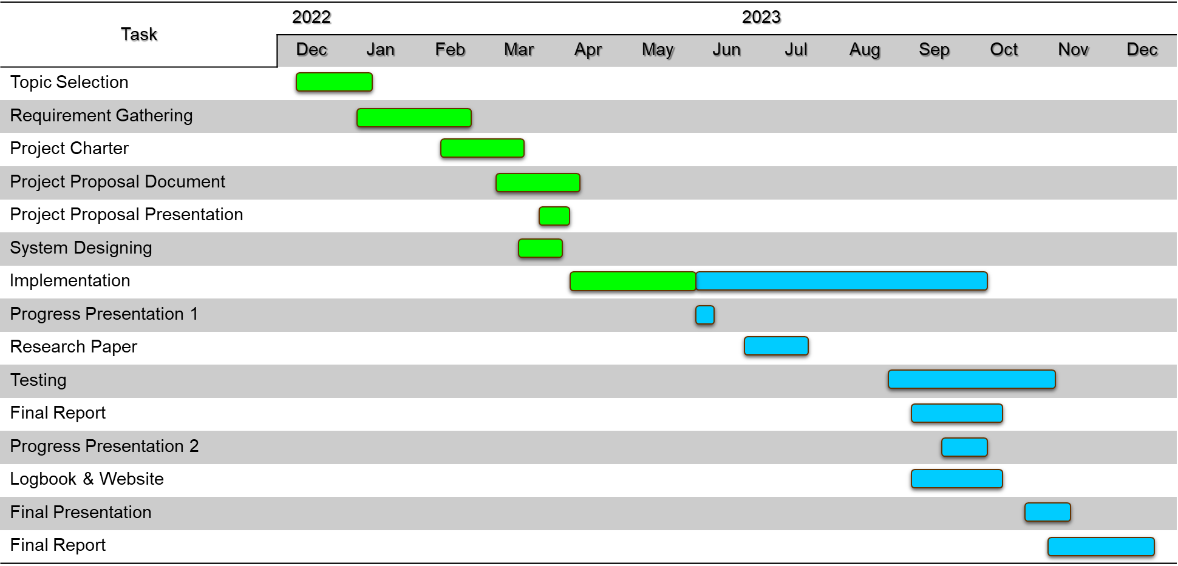
Gantt Chart
IT19973470 | Gunawardana I.I.E | 2023-044

Slide 29
References
[1] L. Grimstad and P. J. From, “Thorvald II - a Modular and Re-configurable Agricultural Robot,” IFAC-PapersOnLine, vol. 50, no. 1, pp. 4588–4593, 2017, doi: 10.1016/j.ifacol.2017.08.1005.
[2] Cihan YURTSEVER, Y. ERTAS, O. SUSTAM, and C. ULU, “Development of an Agriculture Robot for Row-type Seed Sowing Applications,” J. Selcuk. Spec. Issue 2020 (ICAT’20, vol. 2020, pp. 228–242, 2020.
[3] E. P. Godoy, G. T. Tangerino, R. A. Tabile, R. Y. Inamasu, and A. J. V. Porto, “Networked control system for the guidance of a four-wheel steering agricultural robotic platform,” J. Control Sci. Eng., vol. 2012, 2012, doi: 10.1155/2012/368503.
[4] P. Biber, U. Weiss, M. Dorna, and A. Albert, “Navigation System of the Autonomous Agricultural Robot ‘BoniRob,’” Work. Agric. Robot. Enabling Safe, Effic. Afford. Robot. Food Prod., pp. 1–7, 2012.
[5] T. Mueller-Sim, M. Jenkins, J. Abel, and G. Kantor, “The Robotanist: A ground-based agricultural robot for high-throughput crop phenotyping,” Proc. - IEEE Int. Conf. Robot. Autom., pp. 3634–3639, 2017, doi: 10.1109/ICRA.2017.7989418.
IT19973470 | Gunawardana I.I.E | 2023-044

Slide 30
IT20382476 Perera P.V.Y Data Science
IT20382476 | Perera P.V.Y | 2023-044

Slide 31
INTRODUCTION
IT20382476 | Perera P.V.Y | 2023-044

Slide 32
Background
What is Automatic path detection?
How does Automatic path detection work?
How does Automatic Path detection help “TeaBot” to navigate ?^{[1][2]}
How does Automatic Path Detection relate to ?^{[1][2]}
IT20382476 | Perera P.V.Y | 2023-044

Slide 33
Research Question
How can a suitable algorithm be created to detect the path and address TeaBot’s navigation problem ?^{[1][2][3][4][5]}
How to design a user-friendly tangible interface to interact with children?
IT20382476 | Perera P.V.Y | 2023-044

Slide 34
OBJECTIVES
IT20382476 | Perera P.V.Y | 2023-044

Slide 35
Specific and Sub Objectives
Main Objective
Develop an Image Segmentation model to precisely detect the navigation path.
Sub-Objectives
Implement a model to accurately segment the path from the background and train the Image Segmentation model using relevant training data.
Test and validate the performance of the developed model in various scenarios, and fine-tune the model and algorithms based on feedback and performance analysis.
IT20382476 | Perera P.V.Y | 2023-044

Slide 36
METHODOLOGY
System Overview Diagram
Technologies
Requirements
Work Breakdown Structure
IT20382476 | Perera P.V.Y.| 2023-044

Slide 37
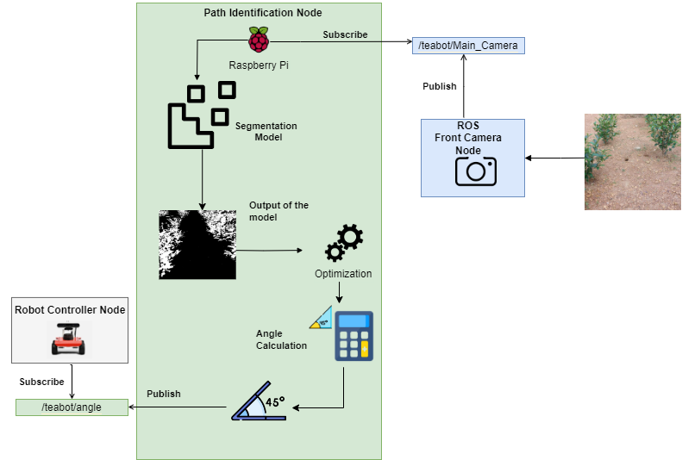
System Overview Diagram
IT20382476 | Perera P.V.Y| 2023-044

Slide 38




Technologies
Technologies
Python
TensorFlow
OpenCV
ROS
Qgis
Keras
Vscode
Google Colab
IT20382476 | Perera P.V.Y | 2023-044

Slide 39
Requirements
Functional Requirements
Non-Functional Requirements
Adaptability
Detecting the center of the path
Image Thresholding and preprocessing data accurately.
Calculate the angle to detect the center of the path
Performance
Efficient
Accuracy
Develop and Counter Extraction
IT20382476 | Perera P.V.Y | 2023-044

Slide 40
Work Breakdown Structure
Tea Stem Identification
Planning
Dataset Creation
Model Development
Testing & Validation
Data Transfer
Identifying requirements
Collecting the dataset
Using Unet architecture
Testing the performance in various scenarios
Transfer the angle
Identifying Algorithm & function
Data preprocessing
Evaluating the performance
Finetune the model based on current performance
Test the robot in actual environment
Identifying the technologies
Labeling
Optimizing the model & offload inferencing
Allocating timeframe
Completed
To Be Completed
IT20382476 | Perera P.V.Y| 2023-044

Slide 41
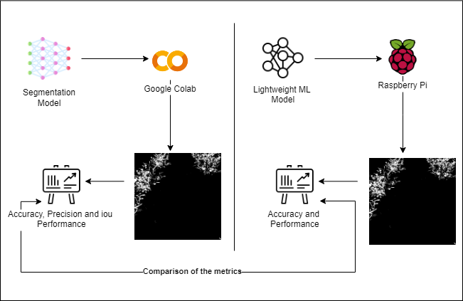
Evaluation
IT20382476 | Perera P.V.Y.| 2023-044

Slide 42
Gannt Chart
IT20382476 | Perera P.V.Y | 2023-044

Slide 43
References
[1] D. Aghi, S. Cerrato, V. Mazzia, and M. Chiaberge, “Deep Semantic Segmentation at the Edge for Autonomous Navigation in Vineyard Rows,” IEEE Int. Conf. Intell. Robot. Syst., pp. 3421–3428, 2021, doi: 10.1109/IROS51168.2021.9635969.
[2] S. Bonadies and S. A. Gadsden, “An overview of autonomous crop row navigation strategies for unmanned ground vehicles,” Eng. Agric. Environ. Food, vol. 12, no. 1, pp. 24–31, 2019, doi: 10.1016/j.eaef.2018.09.001.
[3] S. Jaiswal and M. K. Pandey, “A Review on Image Segmentation,” Adv. Intell. Syst. Comput., vol. 1187, pp. 233–240, 2021, doi: 10.1007/978-981-15-6014-9_27.
[4] T. Zhou, W. Wang, E. Konukoglu, and L. Van Goo, “Rethinking Semantic Segmentation: A Prototype View,” Proc. IEEE Comput. Soc. Conf. Comput. Vis. Pattern Recognit., vol. 2022-June, pp. 2572–2583, 2022, doi: 10.1109/CVPR52688.2022.00261.
[5] T. T. P. Quoc, T. T. Linh, and T. N. T. Minh, “Comparing U-Net Convolutional Network with Mask R-CNN in Agricultural Area Segmentation on Satellite Images,” Proc. - 2020 7th NAFOSTED Conf. Inf. Comput. Sci. NICS 2020, pp. 124–129, 2020, doi: 10.1109/NICS51282.2020.9335856.
IT20382476 | Perera P.V.Y | 2023-044

Slide 44
IT20265410 Premathilake H.T.M Information Technology
IT20265410 | Premathilake H.T.M | 2023-044

Slide 45
INTRODUCTION
IT20265410 | Premathilake H.T.M | 2023-044

Slide 46
Background
What is stem identification?
How to identify the stem? [1],[2]
How stem identification works?
How does stem identification helps "TeaBot" to do feralization process?
IT20265410 | Premathilake H.T.M | 2023-044

Slide 47
Research Gap
Not exclusively focused on the tea plantation and preservation.
Studies have not been conducted to identify the end of the tea stem [3],[4],[5],[6].
Not aligned with the liquid fertilizing process.
Identify the variability in tea stem growth patterns.
Use machine learning techniques, compared to other methodologies.
IT20265410 | Premathilake H.T.M | 2023-044

Slide 48
Research Question
How to give the coordinates of the end of the tea stem in order to fulfill the liquid fertilizing process?
IT20265410 | Premathilake H.T.M | 2023-044

Slide 49
OBJECTIVES
IT20265410 | Premathilake H.T.M | 2023-044

Slide 50
Specific and Sub Objectives
Main Objective
Develop an image processing algorithm to precisely identify the end of the stem and pass the coordinators to the liquid spraying controller.
Sub-Objectives
Gathered dataset and apply preprocessing techniques
Developing, testing and optimizing the image processing model
Developing a lightweight model based on ResNet50 to run on Raspberry Pi
Transfer data to liquid spraying controller
IT20265410 | Premathilake H.T.M | 2023-044

Slide 51
METHODOLOGY
System Overview Diagram
Technologies
Requirements
Work Breakdown Structure
IT20265410 | Premathilake H.T.M | 2023-044

Slide 52
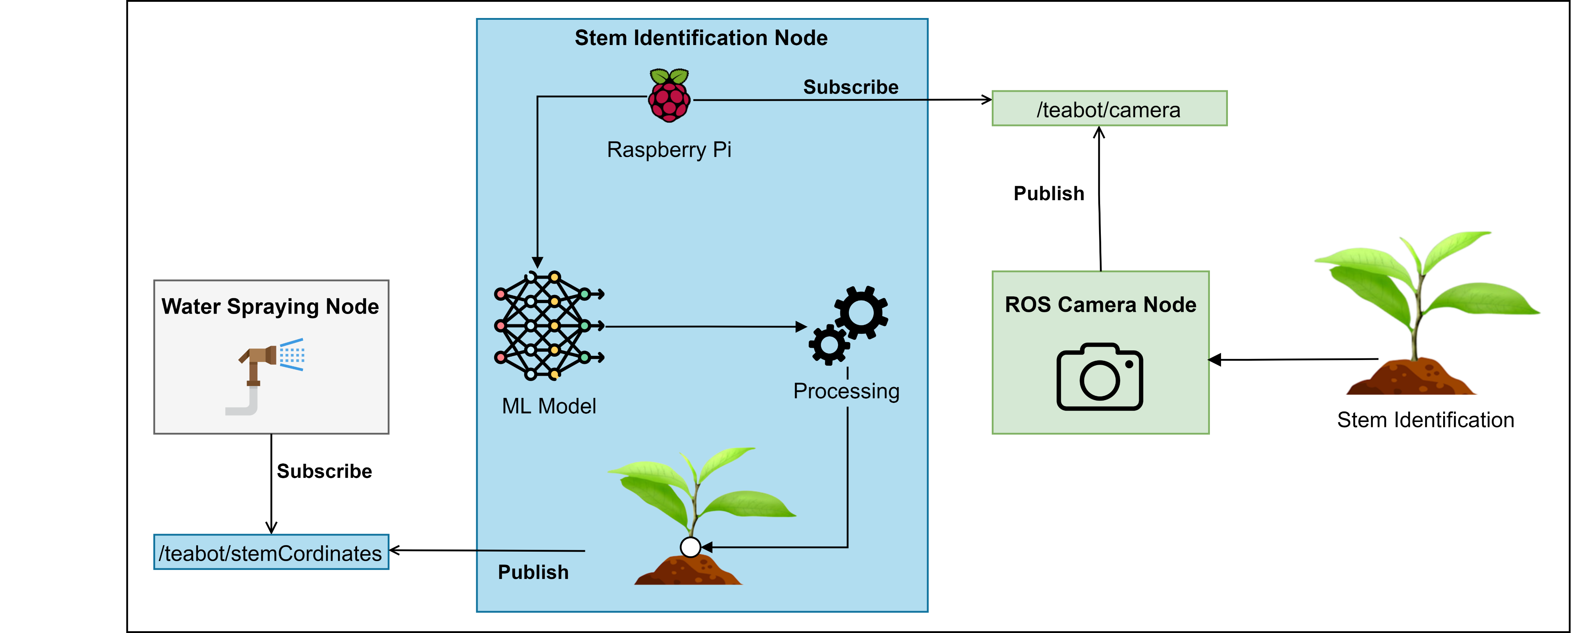
System Overview Diagram
IT20265410 | Premathilake H.T.M | 2023-044

Slide 53
Technologies
Technologies
Python
TensorFlow
OpenCV
ROS
Keras
Google Colab
ResNet Architecture
IT20265410 | Premathilake H.T.M | 2023-044

Slide 54
Requirements
Functional Requirements
Non-Functional Requirements
Adaptability
Capability to get the correct coordinates
Precisely identify the end of the tea stem
Capability to pass the accurate coordinates to the liquid spraying controller
Performance
Efficient
Accuracy
IT20265410 | Premathilake H.T.M | TMP-23-044

Slide 55
Work Breakdown Structure
Tea Stem Identification
Planning
Dataset Creation
Model Development
Testing & Validation
Data Transfer
Identifying requirements
Collecting the dataset
Using ResNet architecture
Testing and verifying accuracy
Integrating the ML model
Identifying Algorithm & function
Data preprocessing
Developing a lightweight model
Evaluating the performance
Transferring the coordinators
Identifying the technologies
Labeling
Optimizing the model
Validating the output result
Allocating timeframe
Completed
To Be Completed
IT20265410 | Premathilake H.T.M | 2023-044

Slide 56
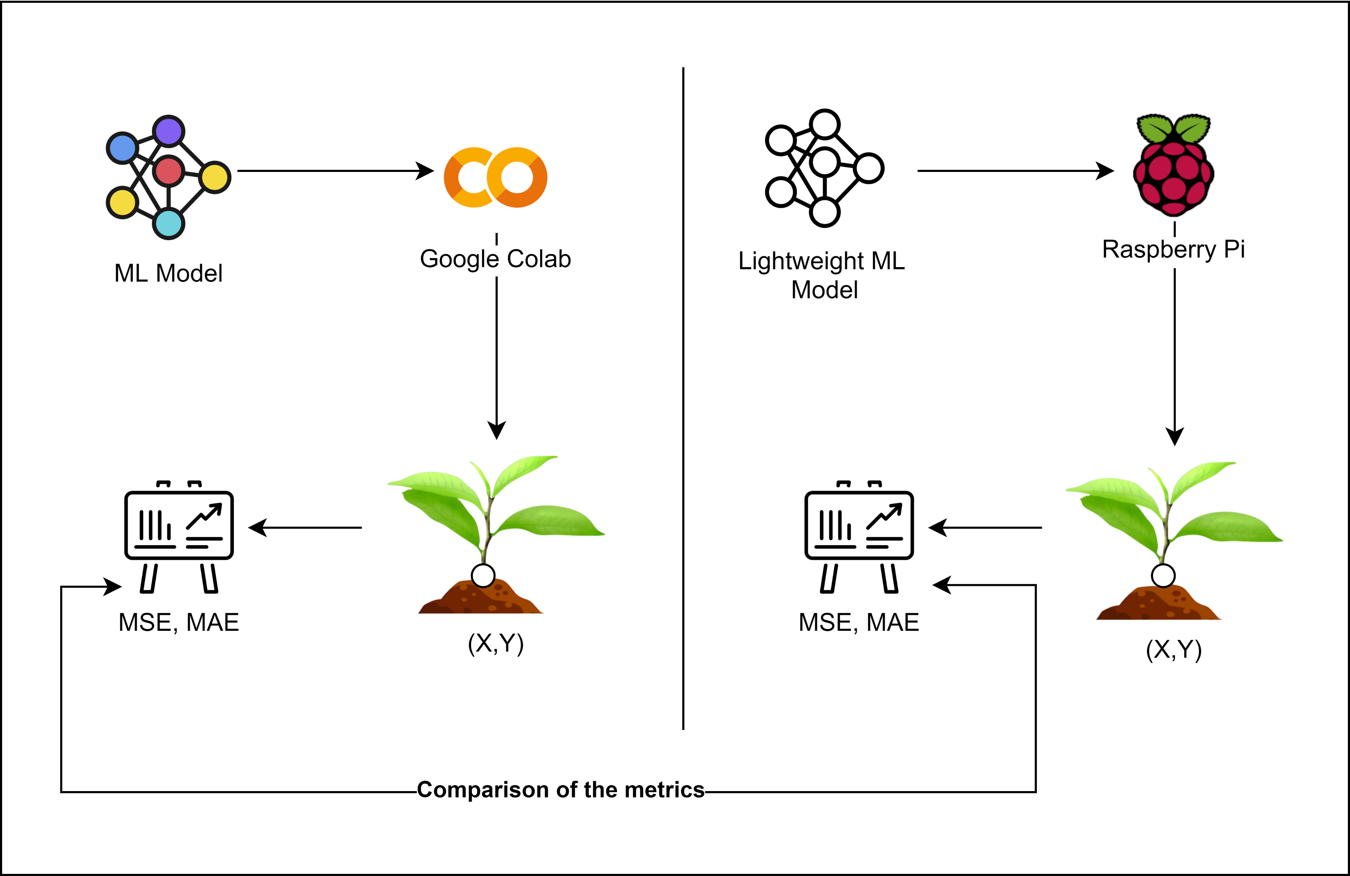
Evaluation
IT20265410 | Premathilake H.T.M | 2023-044

Slide 57
Gantt Chart
IT20265410 | Premathilake H.T.M | 2023-044

Slide 58
References
[1] “Localised feature comparison between VGG-16 and ResNet-50. Although... | Download Scientific Diagram.” https://www.researchgate.net/figure/Localised-feature-comparison-between-VGG-16-and-ResNet-50-Although-both-models-extracted_fig6_328440990 (accessed May 11, 2023).
[2] “Accuracy and loss values for the VGG16 and ResNet50 models on the... | Download Scientific Diagram.” https://www.researchgate.net/figure/Accuracy-and-loss-values-for-the-VGG16-and-ResNet50-models-on-the-GAN-augmented-dataset_fig1_352142241 (accessed May 11, 2023).
[3] L. A. Wells and W. Chung, “Real-Time Computer Vision for Tree Stem Detection and Tracking,” For. 2023, Vol. 14, Page 267, vol. 14, no. 2, p. 267, Jan. 2023, doi: 10.3390/F14020267.​
[4] C. W. Bac, J. Hemming, and E. J. Van Henten, “Stem localization of sweet-pepper plants using the support wire as a visual cue,” Comput. Electron. Agric., vol. 105, pp. 111–120, Jul. 2014, doi: 10.1016/J.COMPAG.2014.04.011.​
[5] R. P. Haff, D. C. Slaughter, and E. S. Jackson, “X-Ray Based Stem Detection in an Automatic Tomato Weeding System,” Appl. Eng. Agric., vol. 27, no. 5, pp. 803–810, 2011, doi: 10.13031/2013.39559.​
[6] W. Wang, C. Li, K. Wang, L. Tang, P. F. Ndiluau, and Y. Cao, “Sugarcane stem node detection and localization for cutting using deep learning,” Front. Plant Sci., vol. 13, p. 5181, Dec. 2022, doi: 10.3389/FPLS.2022.1089961/BIBTEX.
IT20265410 | Premathilake H.T.M | 2023-044

Slide 59
IT20011970 Bamunusinghe G.P Software Engineering
IT20011970 | Bamunusinghe G.P | 2023-044

Slide 60
INTRODUCTION
IT20011970 | Bamunusinghe G.P | 2023-044

Slide 61
Background
The movement of the robot arm and the liquid nozzles must be precisely controlled to ensure the accuracy and efficiency of the application.
The velocity of the robot affects the movement of the robotic arm’s movement of the liquid nozzles, and this must be taken into account in the control system.
PID control is a widely used method for fine-tuning the movement of robotic arms[5], including the movement of liquid nozzles in liquid sprayer systems.
Regulating water pressure is also important to ensure consistent application, and detecting and responding to water blockages can prevent damage to crops and the environment.
IT20011970 | Bamunusinghe G.P | 2023-044

Slide 62
Research Gap
Most of spraying systems waste lots of water and efficiency is low [9].
There is no specific system to detect root and water them accurately.
There is no specific system to validate water spraying path.
For tea plants, misting fertilizer is not recommended.
Most of the systems do not have stabilizing water spraying nozzles.
IT20011970 | Bamunusinghe G.P | 2023-044

Slide 63
Research Question
How to water the plants precisely according to the coordinates with the relative velocity of the robot ?
IT20011970 | Bamunusinghe G.P | 2023-044

Slide 64
OBJECTIVES
IT20011970 | Bamunusinghe G.P | 2023-044

Slide 65
Specific and Sub Objectives
Main Objective
To Develop the liquid nozzles controller of the TeaBot to liquid fertilize the tea plants more efficiently.
Sub-Objectives
Develop the motor controlling for the nozzles with PID controls.
Move the liquid nozzles to the exact spot with the given coordinates by the controller.
Develop the nozzle movements with the given coordinates by computer vision
To move the nozzles with the relative velocity of the robot.
To regulate water pressure and, if water blocks occur, have the system turn itself off
IT20011970 | Bamunusinghe G.P | TMP-23-044

Slide 66
METHODOLOGY
System Overview Diagram
Technologies
Requirements
Work Breakdown Structure
IT20011970 | Bamunusinghe G.P | 2023-044

Slide 67
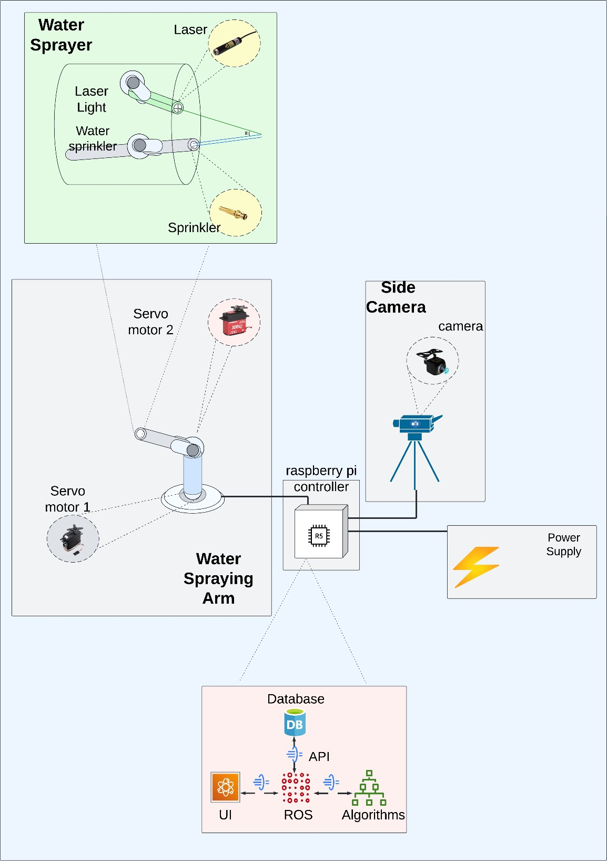
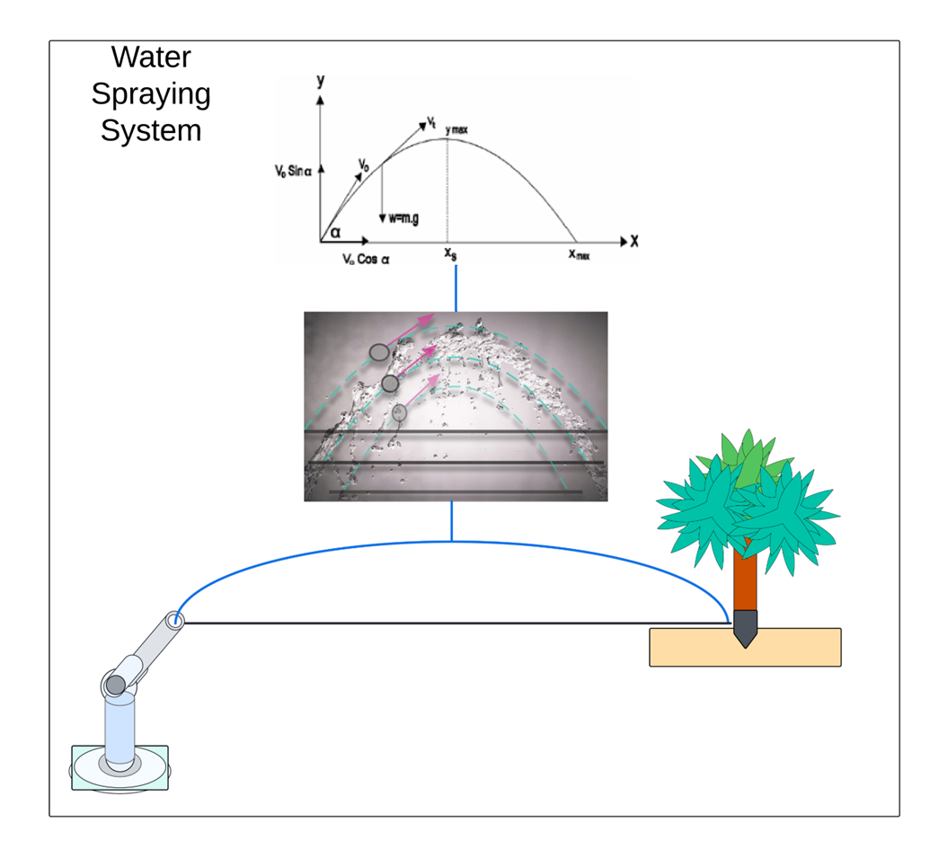
System Overview Diagram
IT20011970 | Bamunusinghe G.P | 2023-044

Slide 68


Technologies
Technologies
Python
ROS
Algorithms
PID
Servo Motor Control
Raspberry Pi
Ubuntu
Solid Works
Angular
Arduino
Stabilizer
IT20011970 | Bamunusinghe G.P | 2023-044

Slide 69
Requirements
Functional Requirements
Non-Functional Requirements
Accuracy
Performance
Speed
Water spraying to the stem
Rotation of the water arm
Water spraying angle control
Water pressure control
Reusability
IT20011970 | Bamunusinghe G.P | 2023-044

Slide 70
Work Breakdown Structure
Liquid Sprayer
Arm & Hardware
Algorithm & Software
Laser Tracker
Mechanical design
Ideation
Mechanical design
3D printing
Coding
Hardware development
Firmware
Testing
Assembling
Assembling
Completed
To Be Completed
IT20011970 | Bamunusinghe G.P | TMP-23-044

Slide 71
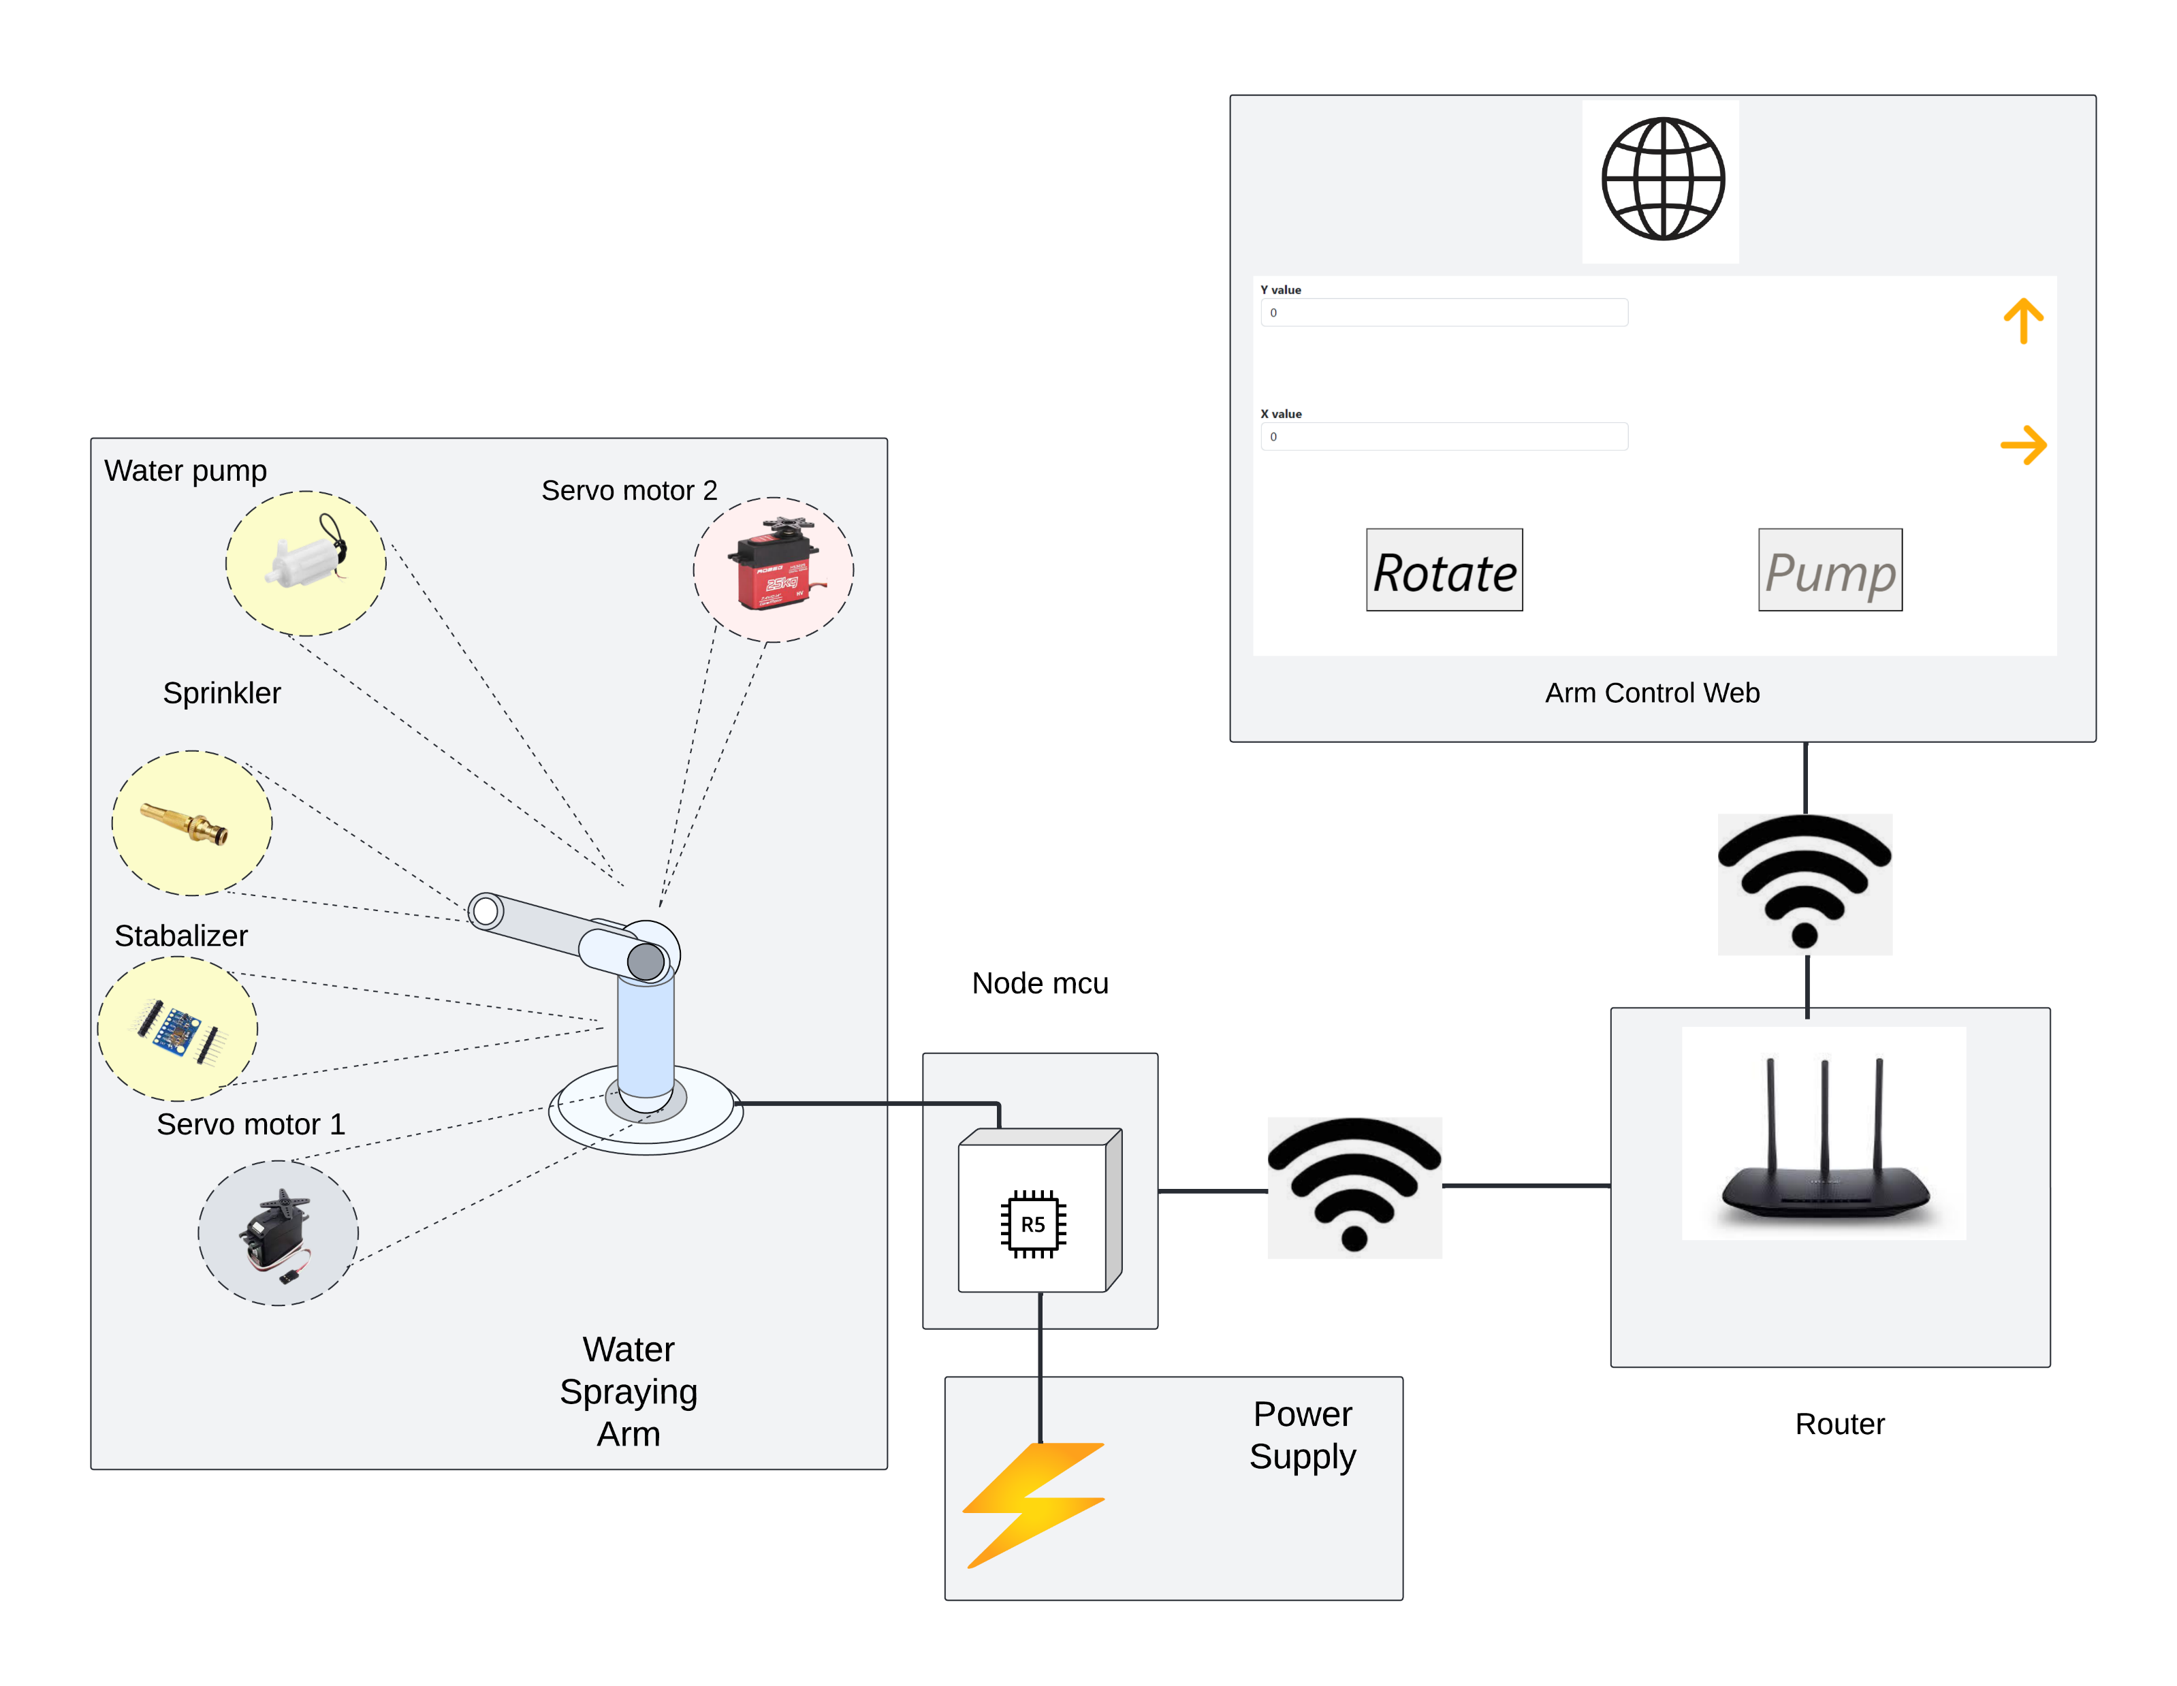
Evaluation
IT20011970 | Bamunusinghe G.P | 2023-044

Slide 72
Gannt Chart
IT20011970 | Bamunusinghe G.P | 2023-044

Slide 73
References
[1]A. Shilpa, V. Muneeswaran, and D. Devi Kala Rathinam, “A Precise and Autonomous Irrigation System for Agriculture: IoT Based Self Propelled Center Pivot Irrigation System,” 2019 5th Int. Conf. Adv. Comput. Commun. Syst. ICACCS 2019, pp. 533–538, Mar. 2019, doi: 10.1109/ICACCS.2019.8728550.
[2] a G. Smajstrla et al., “Efficiencies of Florida Agricultural Irrigation Systems,” BUL247, Univ. Florida, no. July 2002, p. 14, 2002.
[3] A. Heideker, D. Ottolini, I. Zyrianoff, A. T. Neto, T. Salmon Cinotti, and C. Kamienski, “IoTbased Measurement for Smart Agriculture,” 2020 IEEE Int. Work. Metrol. Agric. For. MetroAgriFor 2020 - Proc., pp. 68–72, 2020, doi: 10.1109/MetroAgriFor50201.2020.9277546.
[4] D. Cooley, R. M. Maxwell, and S. M. Smith, “Center Pivot Irrigation Systems and Where to Find Them: A Deep Learning Approach to Provide Inputs to Hydrologic and Economic Models,” Front. Water, vol. 3, Dec. 2021, doi: 10.3389/frwa.2021.786016.
[5] C. Cruz Ulloa, A. Krus, A. Barrientos, J. del Cerro, and C. Valero, “Robotic Fertilization in Strip Cropping using a CNN Vegetables Detection-Characterization Method,” Comput. Electron. Agric., vol. 193, no. January, p. 106684, 2022, doi: 10.1016/j.compag.2022.106684.
[6]“Greenhouse Irrigation - What’s the best watering system? | Greenhouse Emporium.” https://greenhouseemporium.com/blogs/greenhouse-gardening/greenhouse-irrigationsystems/ (accessed Mar. 20, 2023).
IT20011970 | Bamunusinghe G.P | 2023-044

Slide 74
Demonstration

Slide 75
IT19973470 Gunawardana I.I.E Software Engineering
IT19973470 | Gunawardana I.I.E | 2023-044

Slide 76
IT20382476 Perera P.V.Y Data Science
IT20382476 | Perera P.V.Y | 2023-044

Slide 77
IT20265410 Premathilake H.T.M Information Technology
IT20265410 | Premathilake H.T.M | 2023-044

Slide 78
IT20011970 Bamunusinghe G.P Software Engineering
IT20011970 | Bamunusinghe G.P | 2023-044

Slide 79
Q & A

Slide 80
THANK YOU!

